Slide 1
Vali IT
Vue JS

Slide 2
DEMO
Kes tahab kaasa teha siis installige NPM
https://www.npmjs.com/get-npm
Kontrollige CMD-s:
node –v
npm -v

Slide 3
DEMO
Windows: npm i –g @vue/cli
Mac: sudo npm i –g @vue/cli
vue create {project_name}
Manually select features
Choose only router
Don’t use history mode
In dedicated config files

Slide 4
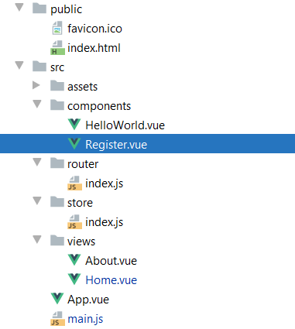
Open project with IntelliJ

Slide 5
Install vue plugin (ultimate edition only)
ctrl+shift+a -> plugins -> vue

Slide 6
Add new page
Copy views/Home.vue -> view/Register.vue
App.vue add:
<router-link to="/register">Register</router-link>
3) router/index.js add:
import Register from '../views/Register.vue'
{ path: "/register", name: "Register", component: Register }

Slide 7
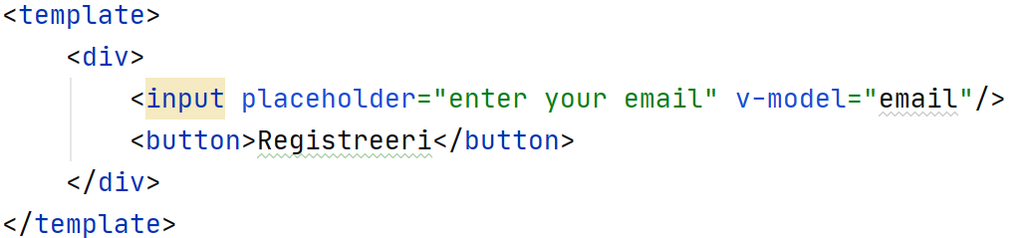
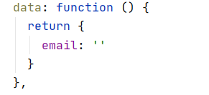
Add content to register page
In Register.vue change template to:
Add data block to export default:

Slide 8
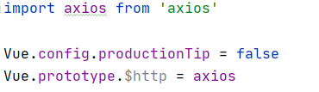
Making http requests
Install Axios: npm install --save axios
In main.js:

Slide 9
Run Application
npm run serve
npm run serve -- --port 8090

Slide 10
Documentation
https://vuejs.org/v2/guide/

